Slide 1
Different government regulatory agencies
Regulatory agencies in the USA and EU
17.2.1 List different government regulatory agencies and describe them
Unit C 17.2 Intro to Medical Equipment Regulation
Module 279-17-C Regulations, Standards and Ethics
dr. Chris R. Mol, BME, NORTEC, 2015

Slide 2
Government tasks (?)
Collect Taxes
income tax
property tax
inheritance tax
sales tax
….
Provide Public Safety
police, army
food regulations
medical equipment safety
Education
primary schools
secondary schools
colleges
universities
Provide Public Utilities
water
electricity
sewage
telephone
Provide Subsidies
Fuel
Maize
….
Healthcare
hospitals
health programs
Provide Public Transport
bus
train
airplane
Establish Laws & Regulations
fair competition
Businesses
copper mines
hydro dams
maize seeds
& sales
Provide Public Infrastructure
roads
government buildings
©
Government Regulatory Agencies
dr. Chris R. Mol, BME, NORTEC, 2015

Slide 3
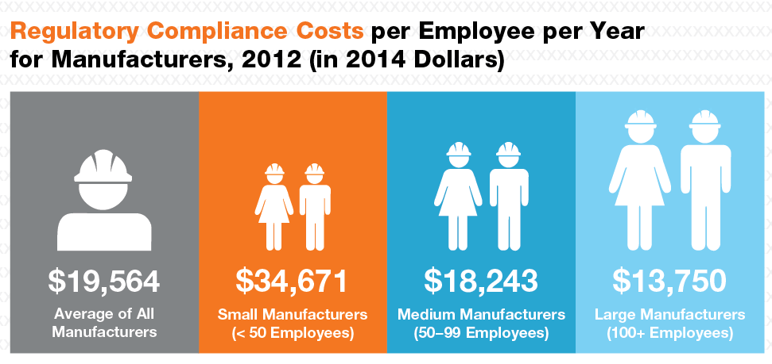
Cost of Regulations
All regulations impose a cost on society (manufacturers, vendors, users, public, government)
to establish and maintain such regulations.
It is important that the cost of regulations is
not higher than necessary and
justified by the (public) benefits
©
Government Regulatory Agencies
dr. Chris R. Mol, BME, NORTEC, 2015

Slide 4
FDA / USA
©
Government Regulatory Agencies
dr. Chris R. Mol, BME, NORTEC, 2015

Slide 5
FDA: the Food and Drug Administration
The Food and Drug Administration (FDA) is a federal agency of the United States Department of Health and Human Services. The FDA is responsible for protecting and promoting public health through the regulation and supervision of:
food safety, tobacco products, dietary supplements, prescription and over-the-counter pharmaceutical drugs (medications), vaccines, biopharmaceuticals, blood transfusions, medical devices, electromagnetic radiation emitting devices (ERED), cosmetics, animal foods & feed and veterinary products.
The agency has 223 field offices and 13 laboratories located throughout the United States.
In 2008, the FDA began to post employees to foreign countries, including China, India, Costa Rica, Chile, Belgium, and the United Kingdom.
In 2010, the FDA had 15,100 employees.
©
Government Regulatory Agencies
dr. Chris R. Mol, BME, NORTEC, 2015

Slide 6
FDA: the Food and Drug Administration
The FDA regulates more than US$1 trillion worth of consumer goods, about 25% of consumer expenditures in the United States. This includes $466 billion in food sales, $275 billion in drugs, $60 billion in cosmetics and $18 billion in vitamin supplements. Much of these expenditures are for goods imported into the United States; the FDA is responsible for monitoring imports.
The FDA's federal budget request for fiscal year (FY) 2012 totalled $4.4 billion. About $2 billion of this budget is generated by user fees. Pharmaceutical firms pay the majority of these fees, which are used to expedite drug reviews.
©
Government Regulatory Agencies
dr. Chris R. Mol, BME, NORTEC, 2015

Slide 7
FDA: the Center for Devices and Radiological Health
The Center for Devices and Radiological Health (CDRH) is the branch of the FDA responsible for
regulating firms who manufacture, repackage, relabel, and/or import medical devices sold in the United States.
the pre-market approval of all medical devices, as well as overseeing the manufacturing, performance and safety of these devices. In addition, CDRH regulates radiation-emitting electronic products (medical and non-medical) such as lasers, x-ray systems, ultrasound equipment, microwave ovens and color televisions.
CDRH regulatory powers include the authority:
to require certain technical reports from the manufacturers or importers of regulated products,
to declare regulated products defective, and
to order the recall of defective or noncompliant products.
CDRH also conducts limited amounts of direct product testing.
©
Government Regulatory Agencies
dr. Chris R. Mol, BME, NORTEC, 2015

Slide 8
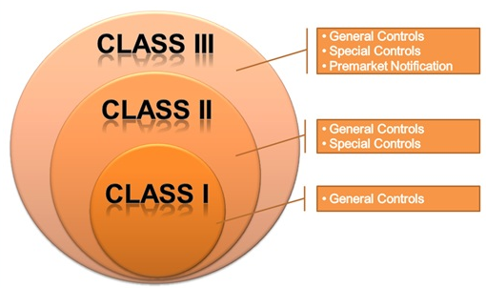
FDA: General Controls
General controls are the minimum regulations that apply to all FDA regulated medical devices.
©
Government Regulatory Agencies
dr. Chris R. Mol, BME, NORTEC, 2015

Slide 9
FDA: General Controls
General controls include the next five elements:
establishment registration — for e.g. manufacturers, distributors and foreign firms
device listing — listing with FDA of all devices to be marketed;
good manufacturing practices (GMP)—manufacturing of devices in accordance with the Quality Systems Regulation (QSR)
labelling — labelling of devices or in vitro diagnostic products;
premarket notification — submission to FDA of a premarket notification 510(k).
©
Government Regulatory Agencies
dr. Chris R. Mol, BME, NORTEC, 2015

Slide 10
EU
©
Government Regulatory Agencies
dr. Chris R. Mol, BME, NORTEC, 2015

Slide 11
EU Legal Framework
The EU aims to remove technical barriers to trade and dispel the consequent uncertainty for economic operators, to facilitate free movement of goods inside the EU.
The core legal framework related to medical devices consists of three directives:
• Directive 90/385/EEC regarding active implantable medical devices
• Directive 93/42/EEC regarding medical devices
• Directive 98/79/EC regarding in vitro diagnostic medical devices
The Medical Device Directive 93/42/EEC of 14 June 1993 concerning medical devices,
is intended to harmonise the laws relating to medical devices within the European Union.
The Directive was most recently reviewed and amended by the 2007/47/EC and a number of changes were made. Compliance with the revised directive became mandatory on March 21, 2010
©
Government Regulatory Agencies
dr. Chris R. Mol, BME, NORTEC, 2015

Slide 12
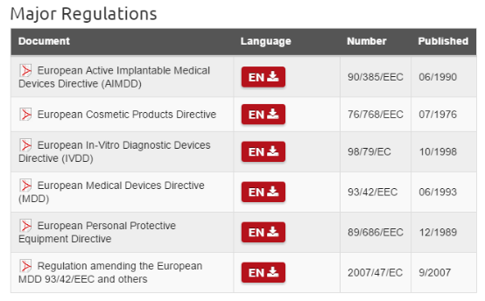
There are a lot of Regulations in the EU …
©
Government Regulatory Agencies
dr. Chris R. Mol, BME, NORTEC, 2015

Slide 13
EU: Competent Authority
The government of each Member State must appoint a
competent authority (CA)
responsible for medical devices.
The competent authority is a body with authority to act on behalf of the member state to ensure that member state government transposes requirements of medical device directives into national law and applies them. The CA reports to the minister of health in the member state.
In the UK, for example, the Medicines and Healthcare products Regulatory Agency (MHRA) acts as a CA
The Regulatory Agencies of the EU countries all have to comply with EU Directives…
©
Government Regulatory Agencies
dr. Chris R. Mol, BME, NORTEC, 2015

Slide 14
EU: Declaration of Conformity
The authorization of medical devices is guaranteed by a Declaration of Conformity.
This declaration is issued by the manufacturer itself.
Medical devices that fit in class I can be marketed purely by self-certification.
For products in higher classes, it must be verified by a Certificate of Conformity issued by a Notified Body.
A Notified Body is a public or private organisation that has been accredited to validate the compliance of the device to the European Directive.
All certified medical devices should have the CE mark on the packaging, insert leaflets, etc.
©
Government Regulatory Agencies
dr. Chris R. Mol, BME, NORTEC, 2015

Slide 15
The CE mark
The CE mark is a conformity mark which all European medical devices must have before they can be marketed.
It is seen as a declaration by the manufacturer that the product meets all the appropriate provisions of the relevant legislation including those related to safety and, where required, has been assessed in accordance with these.
The CE marking of conformity must appear in a visible, legible and indelible form on the device or its sterile pack, where practicable and appropriate, and on the instructions for use. Where applicable, the CE marking must also appear on the sales packaging.
It shall be accompanied by the identification number of the notified body involved.
The initials “CE” do not stand for any specific words; it is a symbol that is seen as a declaration by the manufacturer that the product meets all the appropriate provisions of the relevant legislation.
©
Government Regulatory Agencies
dr. Chris R. Mol, BME, NORTEC, 2015

Slide 16
EU: Essential Principles applicable to all Medical Devices
A1
Medical devices should be designed and manufactured in such a way that, when used under the conditions and for the purposes intended and, where applicable, by virtue of the technical knowledge, experience, education or training, and the medical and physical conditions of intended users, they will perform as intended by the manufacturer and not compromise the clinical condition or the safety of patients, or the safety and health of users or, where applicable, other persons, provided that any risks which may be associated with their use constitute acceptable risks when weighed against the benefits to the patient and are compatible with a high level of protection of health and safety.
©
Government Regulatory Agencies
dr. Chris R. Mol, BME, NORTEC, 2015

Slide 17
EU: Essential Principles applicable to all Medical Devices
A2
The solutions adopted by the manufacturer for the design and manufacture of the devices should conform to safety principles, taking account of the generally acknowledged state of the art. When risk reduction is required, the manufacturer should control the risks so that the residual risk associated with each hazard is judged acceptable.
The manufacturer should apply the following principles in the priority order listed:
identify known or foreseeable hazards and estimate the associated risks arising from the intended use and foreseeable misuse;
eliminate risks as far as reasonably practicable through inherently safe design and manufacture;
reduce as far as reasonably practicable the remaining risks by taking adequate protection measures, including alarms; and
inform users of any residual risks.
©
Government Regulatory Agencies
dr. Chris R. Mol, BME, NORTEC, 2015

Slide 18
EU: Essential Principles applicable to all Medical Devices
A3
Medical devices should achieve the performance intended by the manufacturer and be designed and manufactured in such a way that, during normal conditions of use, they are suitable for their intended purpose.
A4
The characteristics and performances referred to in Clauses A1, A2 and A3 should not be adversely affected to such a degree that the health or safety of the patient or the user and, where applicable, of other persons are compromised during the lifetime of the device, as indicated by the manufacturer, when the device is subjected to the stresses which can occur during normal conditions of use and has been properly maintained in accordance with the manufacturer’s instructions.
©
Government Regulatory Agencies
dr. Chris R. Mol, BME, NORTEC, 2015

Slide 19
EU: Essential Principles applicable to all Medical Devices
A5
Medical devices should be designed, manufactured and packaged in such a way that their characteristics and performances during their intended use will not be adversely affected by transport and storage conditions (for example, fluctuations of temperature and humidity) taking account of the instructions and information provided by the manufacturer
A6
All known and foreseeable risks, and any undesirable effects, should be minimised and be acceptable when weighed against the benefits of the intended performance of medical devices during normal conditions of use.
©
Government Regulatory Agencies
dr. Chris R. Mol, BME, NORTEC, 2015

Slide 20
International Harmonization of Regulations
Medical devices are used worldwide. With the rapid growth in the global market for medical devices, there is a need to harmonize national standards in order to minimize regulatory barriers, facilitate trade and improve access to new technologies.
Harmonization also reduces the cost of implementing regulations for governments and local industry.
We will return to the topic of Harmonization in section 17.3
©
Government Regulatory Agencies
dr. Chris R. Mol, BME, NORTEC, 2015

Slide 21
END
The creation of this presentation was supported by a grant from THET:
see https://www.thet.org/

